Slide 1
AUTOMATED TEA BREWING SYSTEM

Slide 2
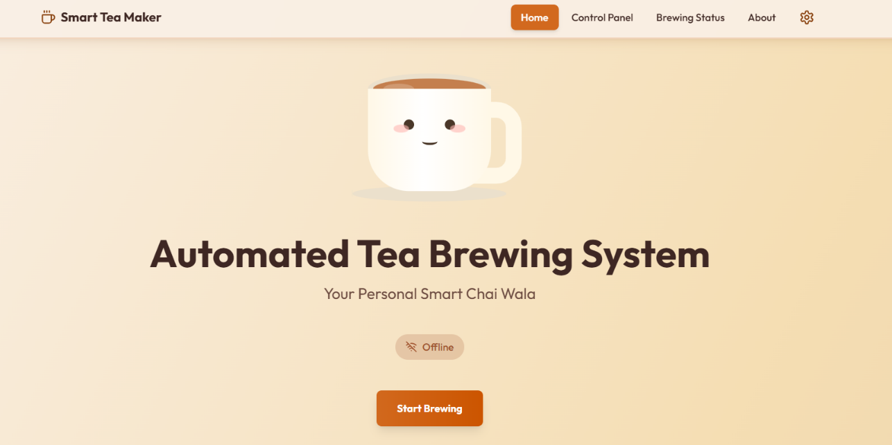

Slide 3
PRESENTED BY:
ALEEHA AIMAN (23-NTU-CS-1243)
NAIMA NAVEED (23-NTU-CS-1032)
ESSHA IMRAN (23-NTU-CS-1022)

Slide 4
Project Overview 1. IoT-based automated tea brewing system 2. Controls complete tea preparation process 3. Reduces manual effort 4. Provides smart and efficient solution 5. Operated through a web-based interface

Slide 5
Objectives
Automate tea preparation
Improve efficiency and consistency
Provide easy user interaction
Enable remote control using IoT
Ensure safe system operation

Slide 6
Technology Stack
ESP32 microcontroller
WiFi-based communication
HTML, CSS, JavaScript (Frontend)
ESP32 Web Server (Backend)
MongoDB (Cloud Database)
Relays, Servo Motors, SSR

Slide 7
Key Features
Web-based control interface
Fully automated brewing sequence
Real-time status monitoring
Remaining time display
Pre-configured tea recipes
Emergency stop functionality

Slide 8
Cloud Integration
Stores tea recipes
Saves user-selected favorite recipes
Enables quick recipe access
Provides centralized recipe management
Supports future cloud expansion

Slide 9
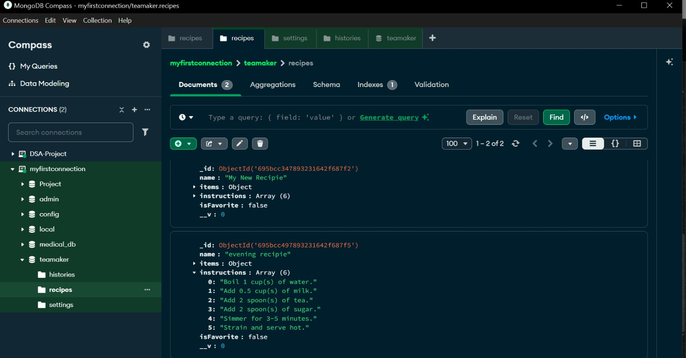

Slide 10
Recipe & Customization options
Automatic Mode
Cloud-stored recipes
Cup selection
Manual Mode
Sugar selection
Milk selection
Water control
Adjustable tea strength

Slide 11
System Architecture
Hardware Layer
Pumps, servos, stove
Control Layer
ESP32, relays, SSR
Software Layer
Web interface
Cloud Layer
MongoDB (Recipes storage)

Slide 12
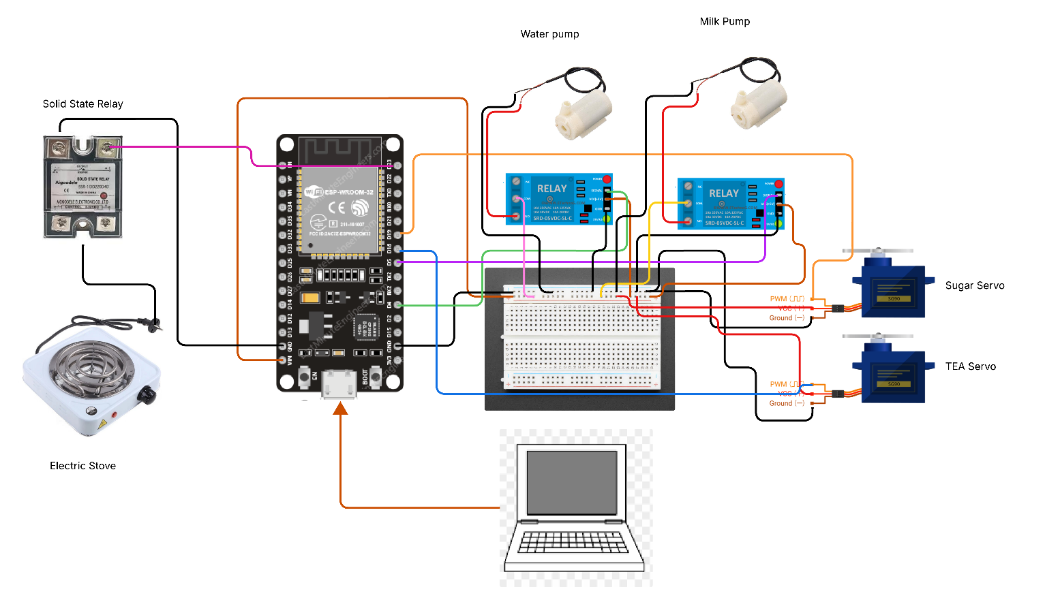

Slide 13
Hardware Components
ESP32 development board
2-channel relay module
DC water and milk pumps
Servo motors for ingredients
Stove for boiling
Solid State Relay (SSR)
Food containers

Slide 14
Hardware Architecture
GPIO 27 → Water pump
GPIO 26 → Milk pump
GPIO 18 → Tea dispenser
GPIO 19 → Sugar dispenser
GPIO 23 → Stove control

Slide 15
Software Architecture
Arduino framework (PlatformIO)
ESP32 WiFi library
WebServer library
REST-based communication
Web-based user interface
MongoDB for recipe storage
Mqtt and node-red

Slide 16
MQTT & NODE-RED
MQTT was used for efficient real-time communication.
Node-RED handled message flow and system control in a visual and scalable manner

Slide 17
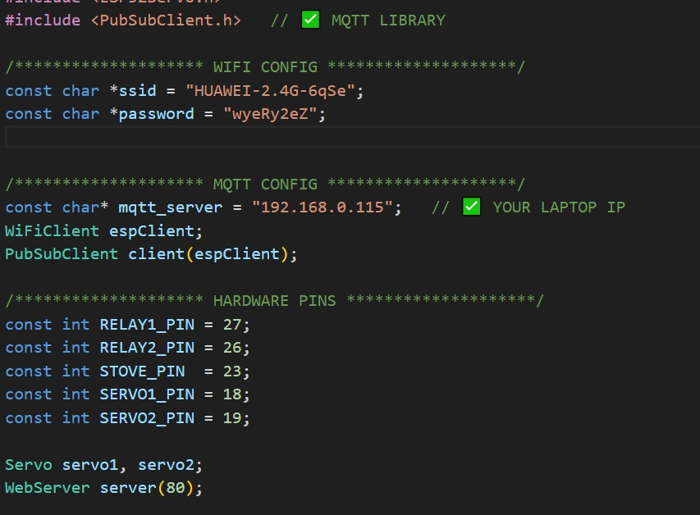

Slide 18
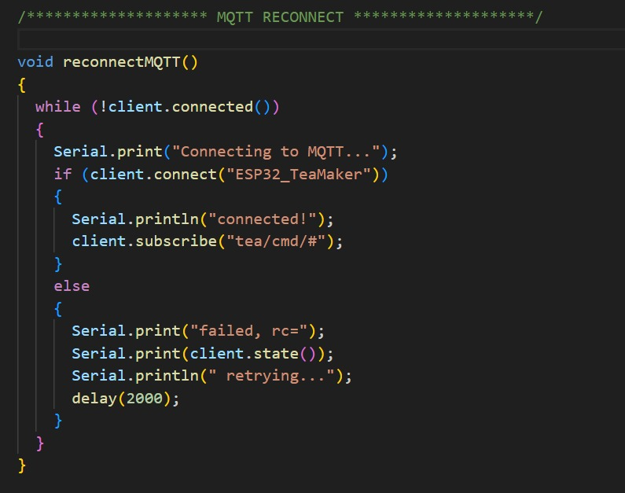

Slide 19
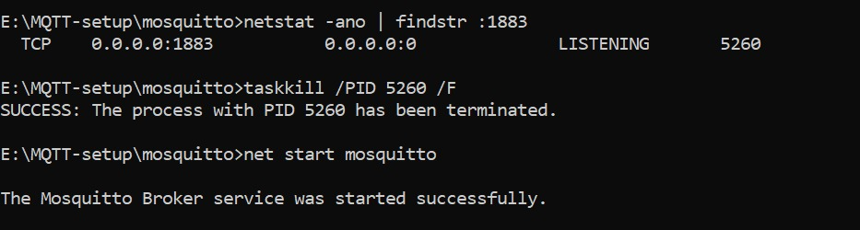

Slide 20
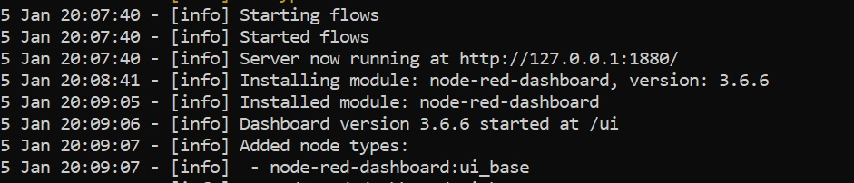

Slide 21
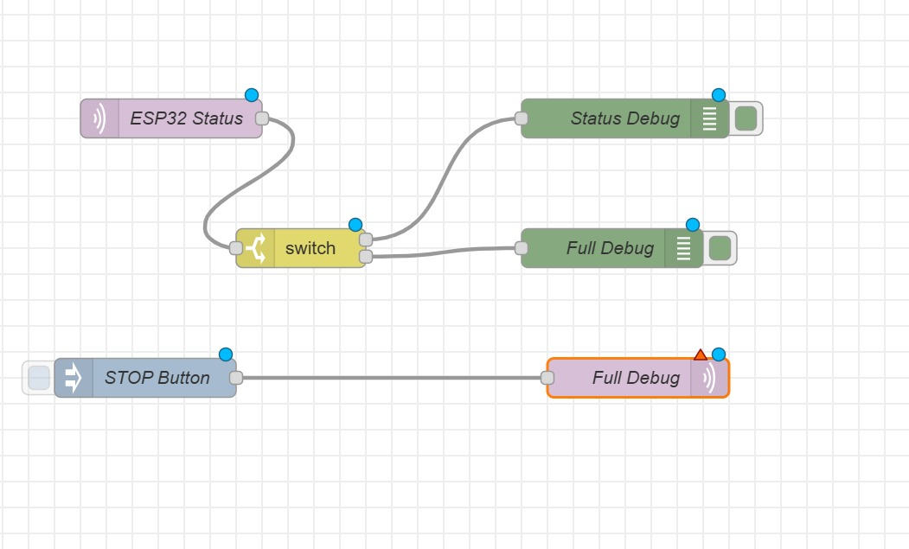

Slide 22
Automatic Stove Control
Stove turns ON automatically
Ingredients collected in pan
Stove turns OFF after tea is ready
Controlled using SSR
Enhances safety and efficiency

Slide 23
User Workflow
Power ON the system
ESP32 connects to WiFi
Open device IP in browser
Select recipe or manual mode
Click Start Brewing
Monitor brewing status
Collect tea after completion

Slide 24
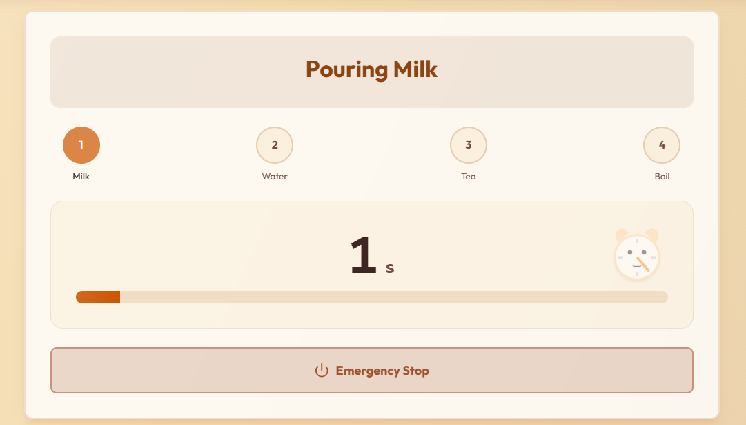

Slide 25
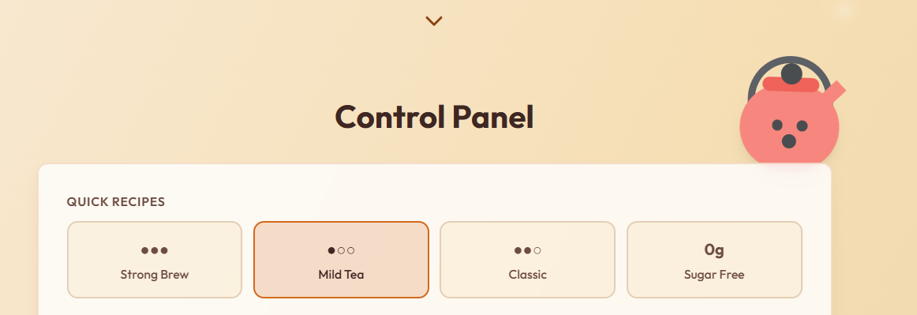

Slide 26
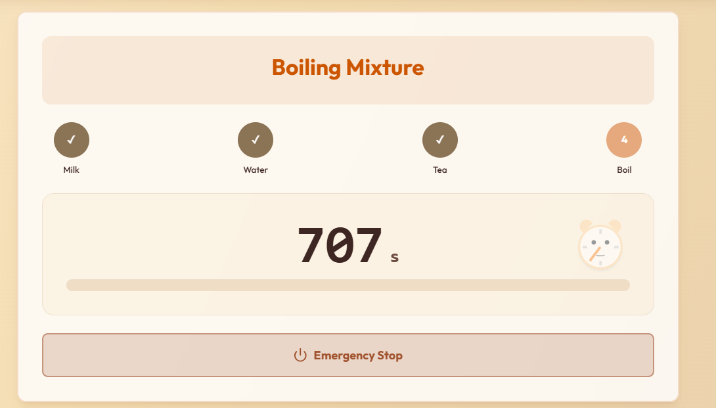

Slide 27
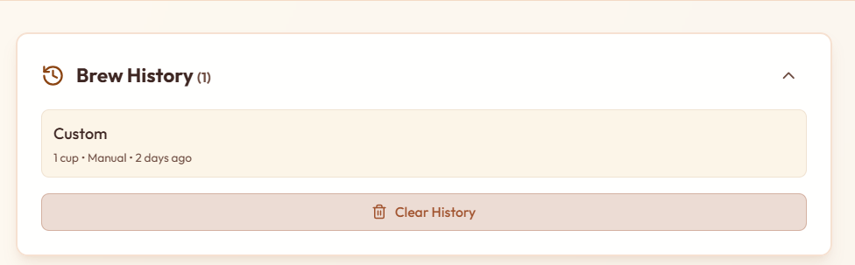

Slide 28
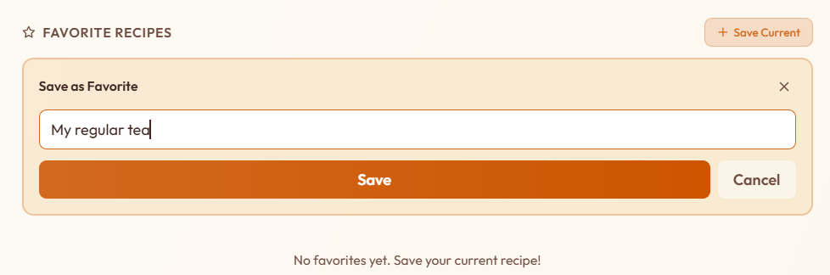

Slide 29
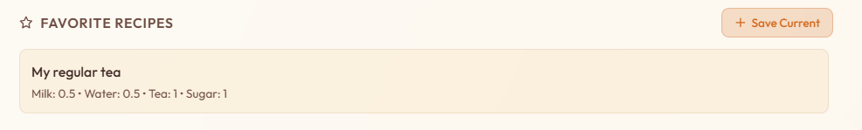

Slide 30
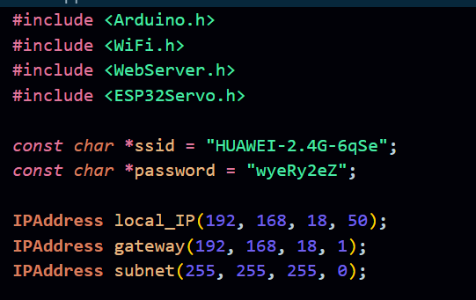
NETWORK
CONFIGURATION

Slide 31
Challenges Faced
Motors not running
Servo motors not rotating
Incorrect timing issues

Slide 32
Solutions Implemented
Relay and power verification
GPIO pin checking
Servo wiring correction
Mechanical inspection
Timing logic adjustment

Slide 33
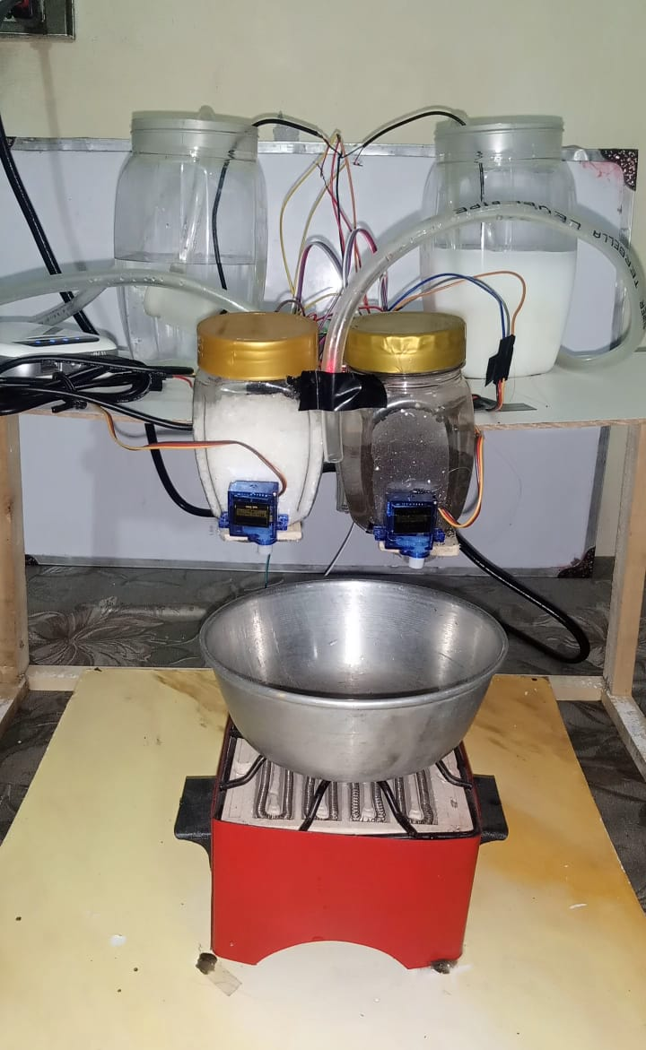

Slide 34
Conclusion
Successfully implemented IoT-based tea automation
Simple and user-friendly system
Reliable hardware and software integration
Cloud used effectively for recipe storage
System ready for future enhancements

